Slide 1


Composite Material with Structural and Power Storage Capabilities
Chris Simpson

Slide 2

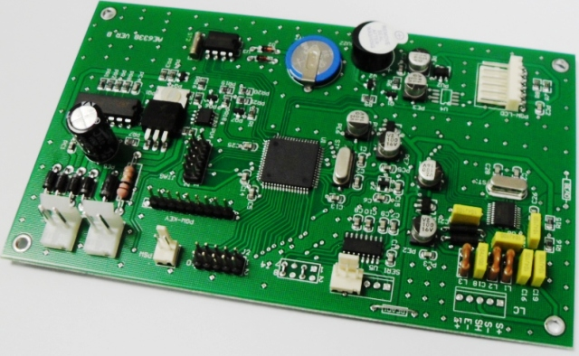
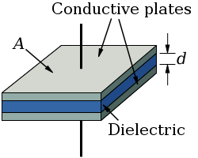
Introduction
Capacitors – electricity storage devices that can charge and discharge instantaneously.
Electrical circuit board with capacitors:
Basic layout of dielectric capacitor:
Photo courtesy of circuitelectronics.info
Photo courtesy of wikipedia.org

Slide 3
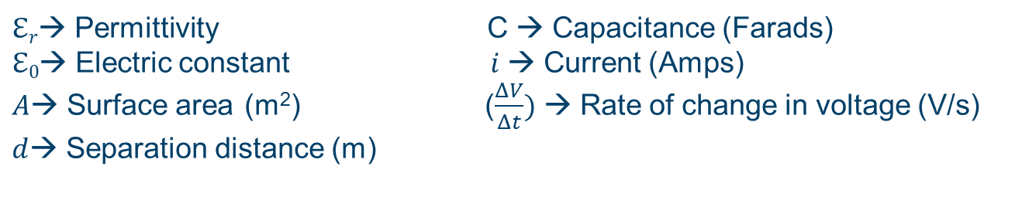

Capacitance
Capacitance can be calculated by:
$C=ℇrℇ0(\frac{A}{d }) C=\frac{i}{(\frac{ΔV}{Δt})}$
2 ways to increase capacitance:
- minimizing the separation distance
- maximizing the surface area
$ℇr$→ Permittivity C → Capacitance (Farads)
$ℇ0$→ Electric constant $i$→ Current (Amps)
$A$→ Surface area (m²) ($\frac{ΔV}{Δt})$ → Rate of change in voltage (V/s)
$d$→ Separation distance (m)

Slide 4
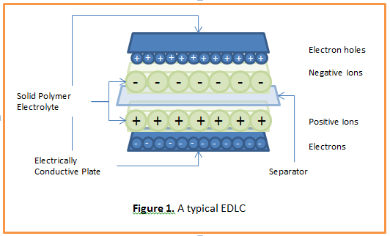
Introduction
Electric Double Layer Capacitors (EDLCs)
- EDLCs use an electrolyte solution with a separator.
- Solid Polymer Electrolyte (SPE) add structual
integrity and allow ion conductivity for high
capacitance

Slide 5
Purpose
Purpose:
Develop EDLCs with structural emphasis
Applications:
Structurally integrated into:
- the body of vehicles
- the skin of aircrafts
- the walls of buildings
- the casings of electronics

Slide 6
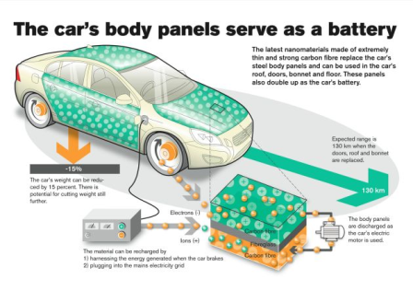
Application

Slide 7
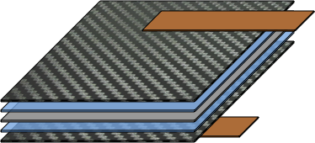
Composite EDLC Layout
Carbon fiber electrode
Lamina
Separator
Lamina
Solid Polymer Electrolyte (SPE)
Matrix
Copper current collectors

Slide 8
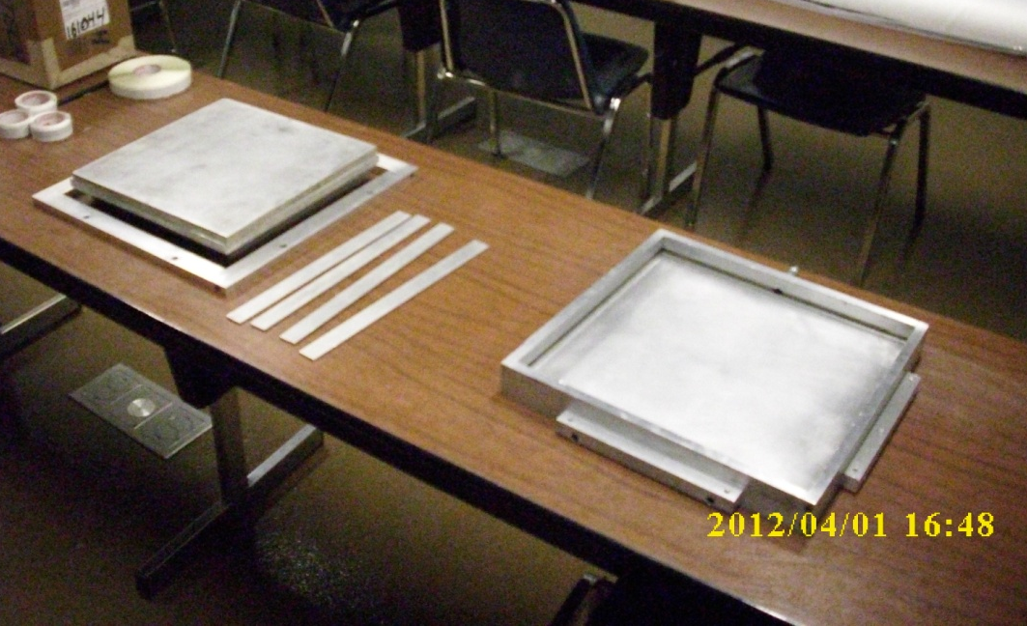
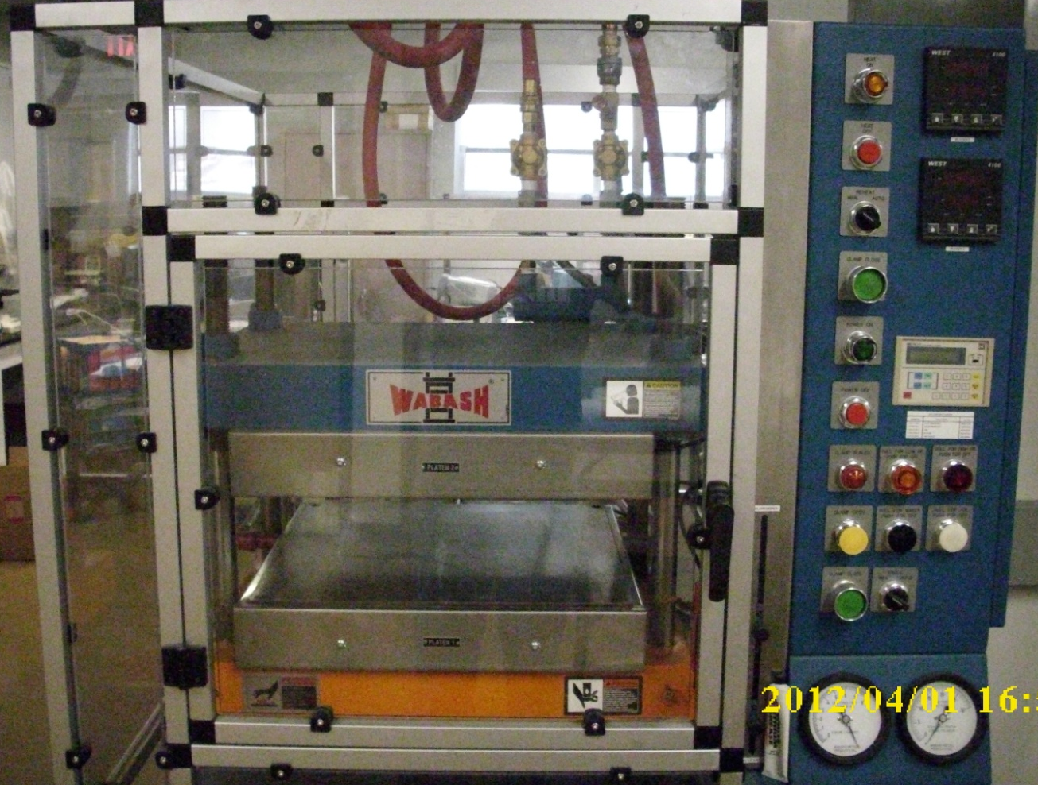
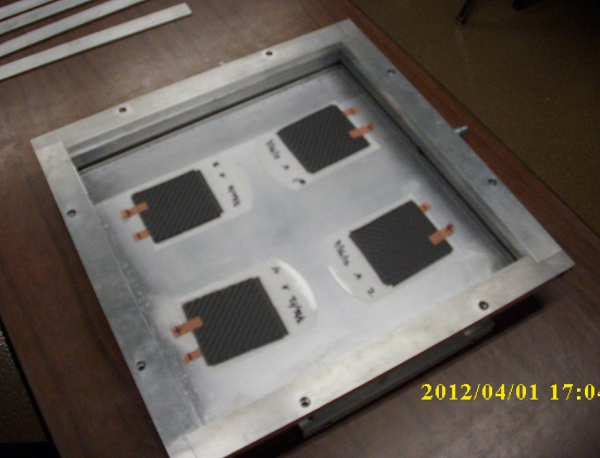
Fabrication
Picture frame mold layout
Mold with finished capacitors
Oven press

Slide 9
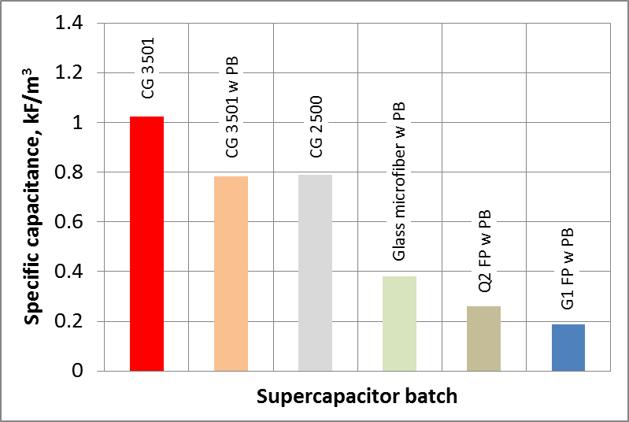
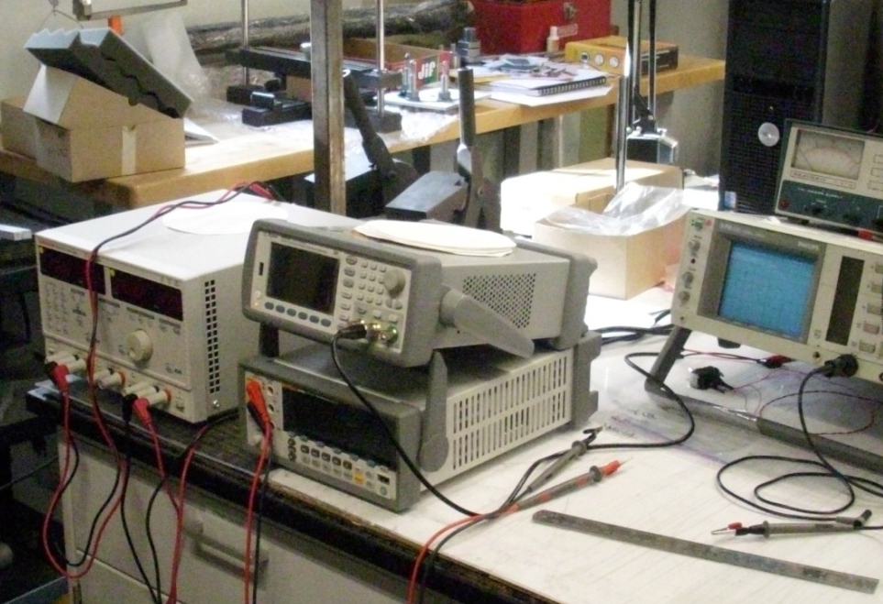
Electrical Testing
Measurement process – cyclic voltametry:
- Induce a charge across capacitor
- Measure capacitance, leakage resistance
Capacitors are tested using a function generator and a digital multimeter (DMM).
Measuring equipment

Slide 10
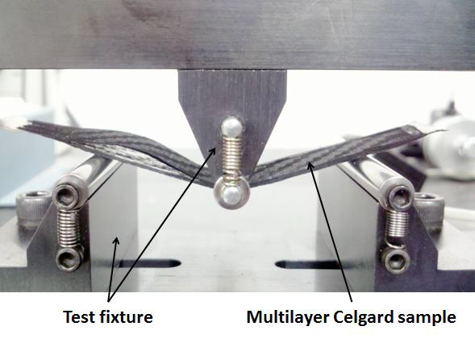
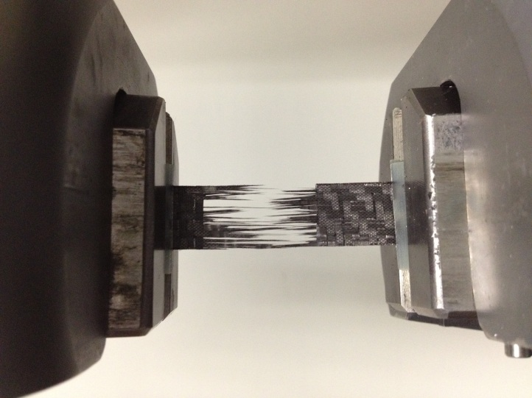
Mechanical Testing
Tension testing (ASTM 3039)
Flexure Testing (ASTM 790)
2500
Grips
3501 Celgard sample

Slide 11
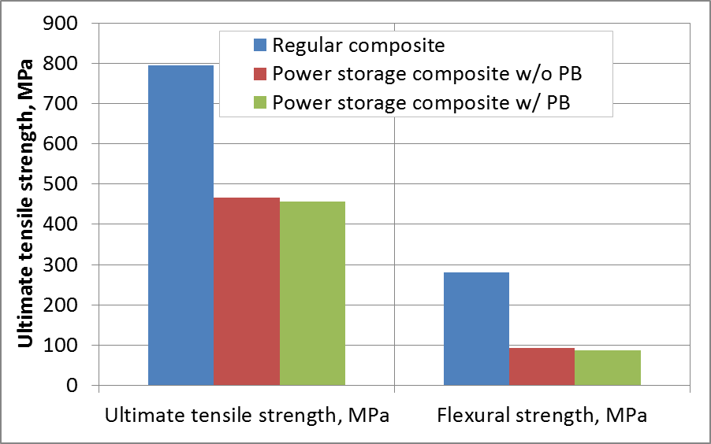
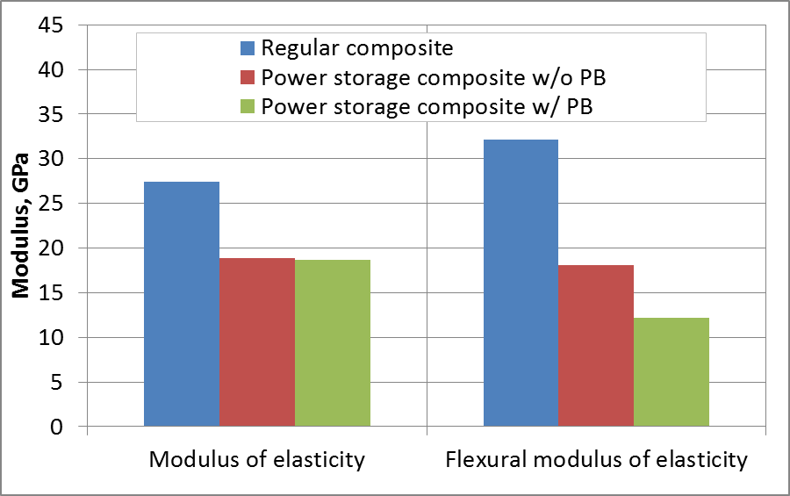
Mechanical Testing Results
Li salt concentration does not
have a significant effect on strength.
Flexural tests
Tensile tests
Composite super-capacitors have strength and stiffness of the same order of magnitude as standard composite materials.

Slide 12
Future Work
Research more solid polymer electrolyte formulations to enhance specific capacitance
as well as mechanical strength.
Experiment with other composite materials

Slide 13
Conclusions
Capacitors with structural capability are feasible.
High energy density is achievable.
The structural properties of the capacitors are comparable with those of regular carbon fiber materials.

Slide 14
Acknowledgements
Thank you to:
NASA/NAU Space Grant
Dr. Barlow
Kathleen Stigmon
Dr. Ciocanel

